Slide 1
Workshop Overview
January 2022 – Extension Activity
8 Jan 2022

Slide 2


Agenda
Welcome (5 min)
Introductions (15 min)
Name
State
School Name
Grades Taught
Cyber-Related Classes / Topics Taught
Workshop Overview (8 minutes)
Raspberry Pi Introduction (8 minutes)
Hardware Boot and Troubleshooting (25 minutes)

Slide 3
Workshop Overview
Introduce and have participants use and run several cybersecurity-related software programs in Kali, running on the Raspberry Pi (RPi).
Introduce the affordable hardware environment of the RPi
Practice using Kali Linux and Linux commands at a command line interface (CLI)
Explore a few of the many pre-installed cybersecurity-related programs on Kali Linux

Slide 4
Organization of the Workshop
Introduction / Practice with Kali
Network forensics with Wireshark
Password auditing using John the Ripper

Slide 5
Raspberry Pi
An Affordable, Flexible Hardware Platform

Slide 6

What is a Raspberry Pi?
Low cost
Small credit-card sized computer
Plugs into a computer monitor or TV
Uses a standard keyboard and mouse
Capable functionality of a desktop computer
Browsing the internet
Playing high-definition video
Making spreadsheets and word-processing
Playing games
https://www.raspberrypi.org/help/what-%20is-a-raspberry-pi/

Slide 7
ARM Processors
ARM is a family of reduced instruction set computer (RISC) architectures for computer processors
Family of processors includes
Raspberry Pi (At its core is an ARMv6 CPU)
Apple M1 is an ARM-based system on a chip (SoC) – Released Nov. 2020
Similar to chips used in iPhone and iPad
Lower power
Many others!
Non-ARM processors in majority of computers: Intel / AMD that uses the x86 complex instruction set (CISC) architecture
https://www.arm.com/

Slide 8

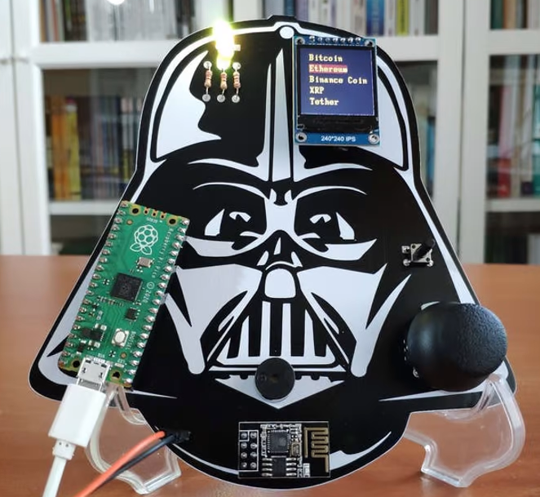
What can RPi do for you?
Small format and affordability – used for many digital maker projects
Examples:
Music machines
Parent detectors
Weather stations
Tweeting birdhouses with infra-red cameras
Simpsons TV
Darth Vader Cryptocurrency Tracker
And sooooo much more!
https://all3dp.com/1/best-raspberry-pi-projects/
Notes:
Simpsons TV: A working desktop TV that plays the Simpsons on loop using a Raspberry Pi Zero W
Vader: Monitor real-time cryptocurrency data and get notified when there is a price depletion or surge with Raspberry Pi Pico and ESP8266 ESP-01.

Slide 9
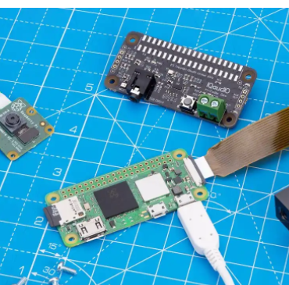
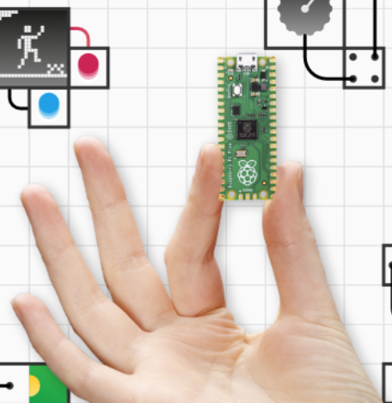
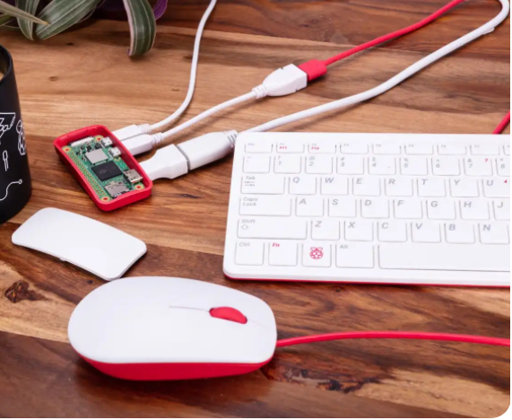
Raspberry Pi Hardware

Slide 10
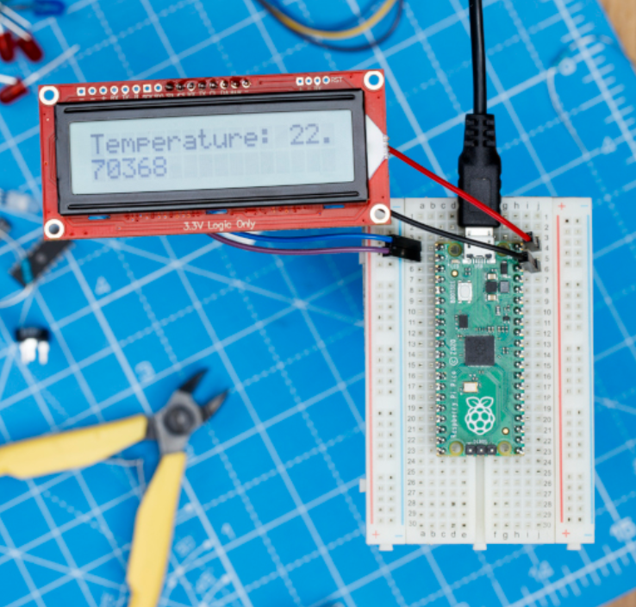
Raspberry Pi Pico (RP2040)
Tiny microcontroller board
$4
https://www.raspberrypi.com/products/raspberry-pi-pico/

Slide 11
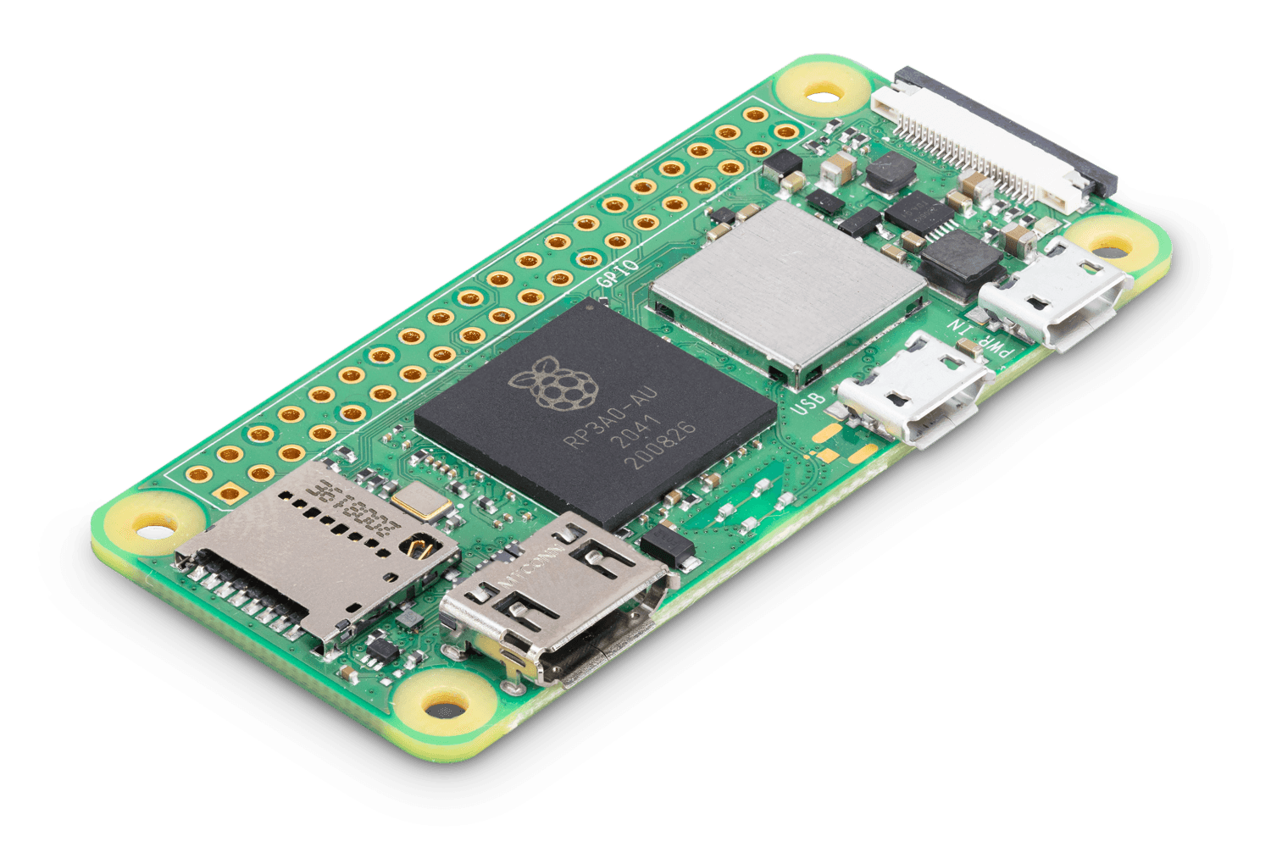
Raspberry Pi Zero 2 W (RP3A0)
Tiny computer
$15
“W” – indicates wireless LAN built in
Quad-core 64-bit ARM Cortex-A53 processor clocked at 1GHz and 512MB of SDRAM
65mm × 30mm form factor
https://www.raspberrypi.com/products/raspberry-pi-zero-2-w/

Slide 12
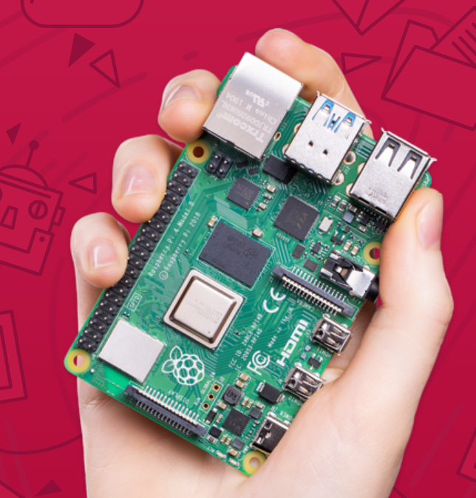
Hardware Formats of the Raspberry Pi
Current version:
Raspberry Pi Model 4 B
Tiny, dual-display, desktop computer
Starting at $35
A more complete description of the all current hardware at https://www.raspberrypi.com/documentation/computers/raspberry-pi.html
https://www.raspberrypi.com/products/raspberry-pi-4-model-b/

Slide 13
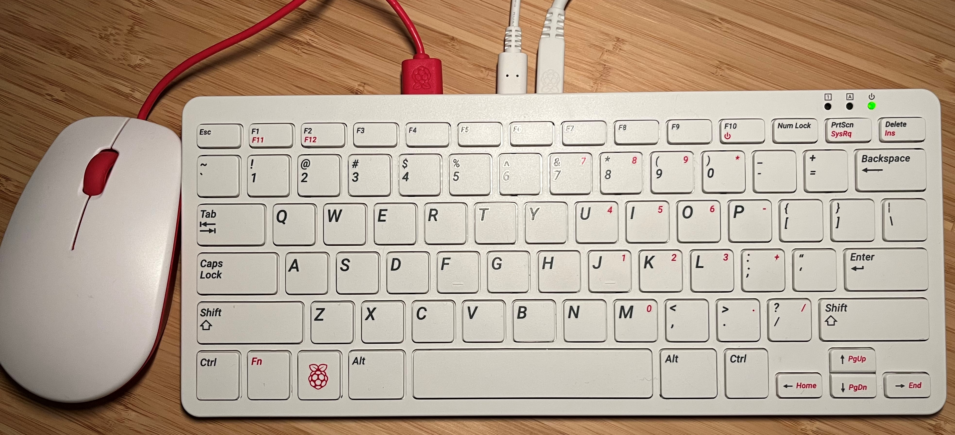
Raspberry Pi 400
Complete personal computer, built into a compact keyboard
Purpose-built board based on Raspberry Pi 4
Quad-core 64-bit processor
4GB of RAM
Wireless networking
Dual-display output and 4K video playback
40-pin GPIO header
This is what you were sent!
https://www.raspberrypi.com/products/raspberry-pi-400/

Slide 14
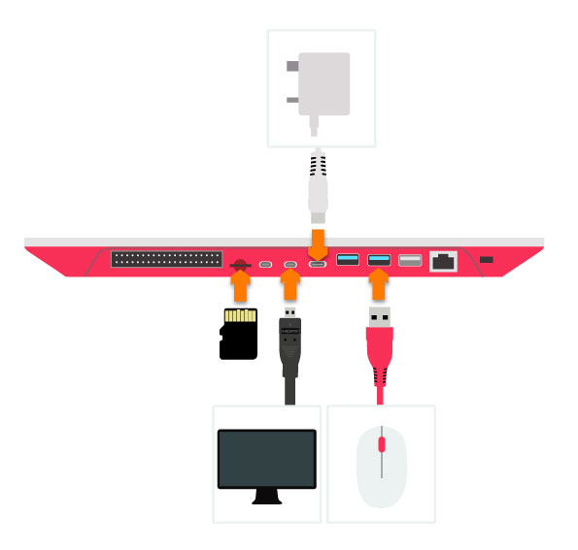
Overall Setup of Raspberry Pi 400
Image from: https://www.okdo.com/getting-started/get-started-with-raspberry-pi-400/

Slide 15
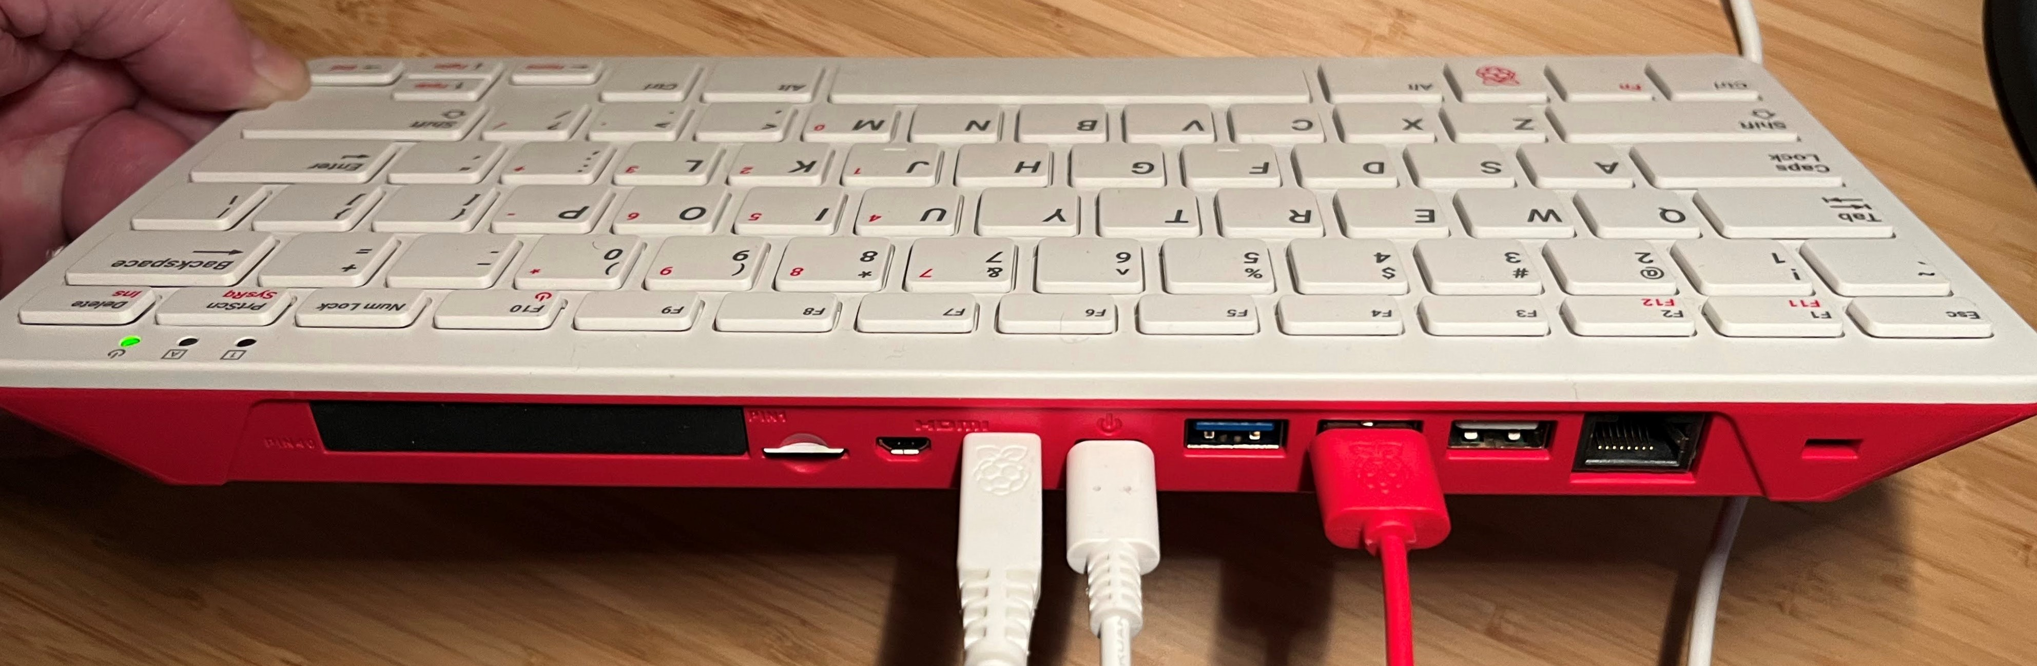
Rear of Raspberry Pi 400
All necessary connections made
Mouse (USB)
Monitor (microHDMI)
Power (USB C)

Slide 16
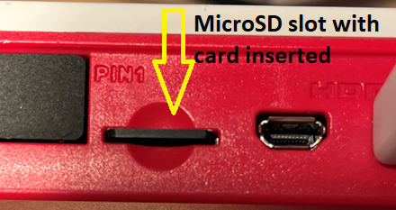
Before Powering Up - Swap the MicroSD Card
If you already have a microSD card inserted, replace it with the 32-bit Kali OS for RPi that was shipped to you.
Push in and when the card pops out, remove it and replace it.
Be sure the pins are facing toward the bottom of the keyboard *and* that you completely push and lock the microSD card into the slot

Slide 17
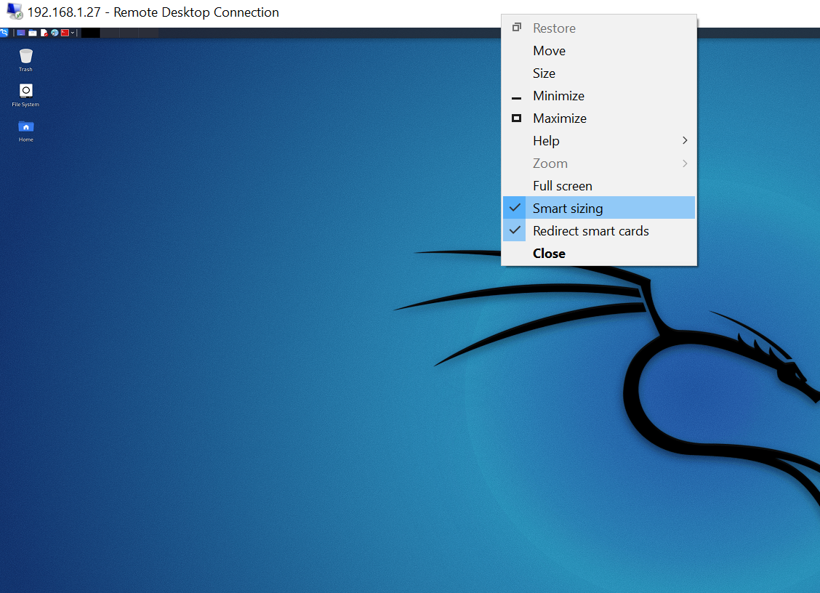
Booting the System
Turn on your monitor
Connect the power
Wait for system to boot
Text will roll by – expected!
Login to system
Username: kali
Password: kali
---------------------
Open a program
Such as Internet browser
Open a command line terminal
Run command such as “ls” to list directory contents

Slide 18

Debrief

Slide 19
Wrap-Up
Homework and Reminders

